Slide 1

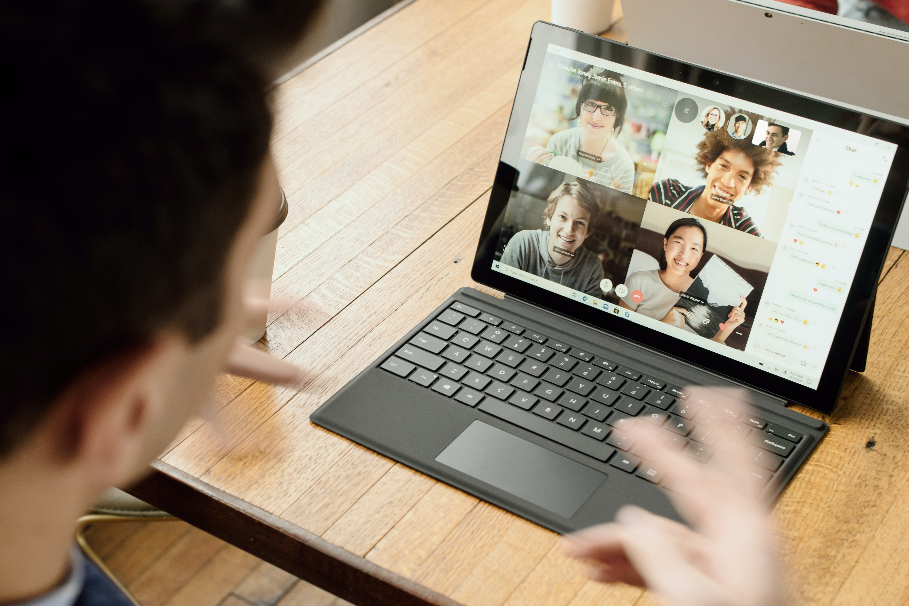
Cracking the Confidence Code

Slide 2

Generation X
Cisgender (She, Her, Hers)
Wife and Mother
Intersectional Feminist
Vermonter by way of Colorado
Woman of Color
Middle-aged
Alexis Kanda-Olmstead
Dartmouth College
Director, Advancement Talent Management
https://www.linkedin.com/in/alexiskandaolmstead/
alexis@dartmouth.edu

Slide 3
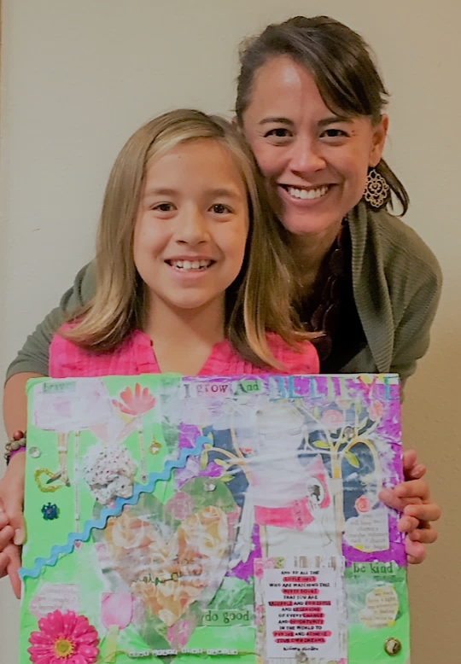
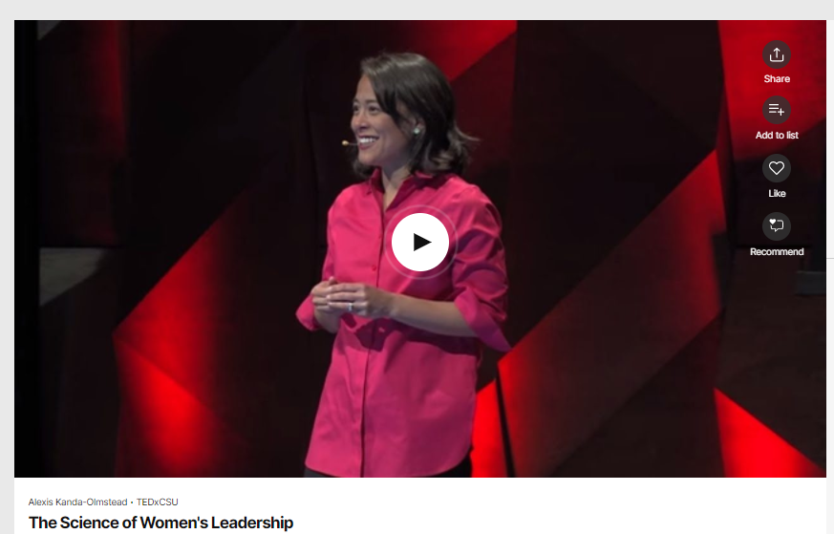
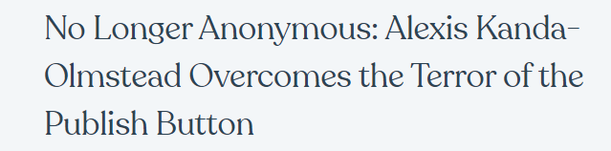
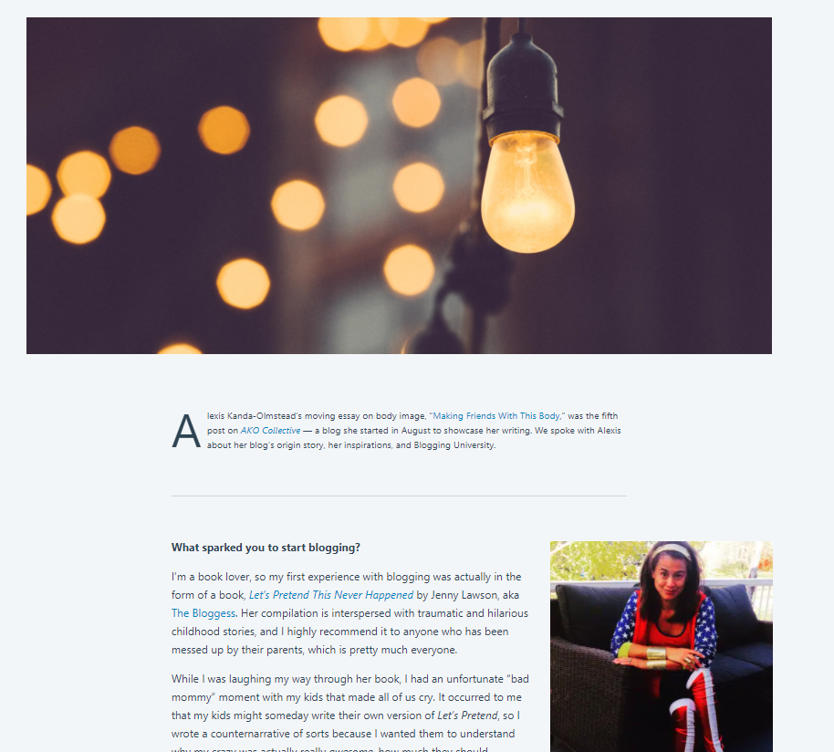

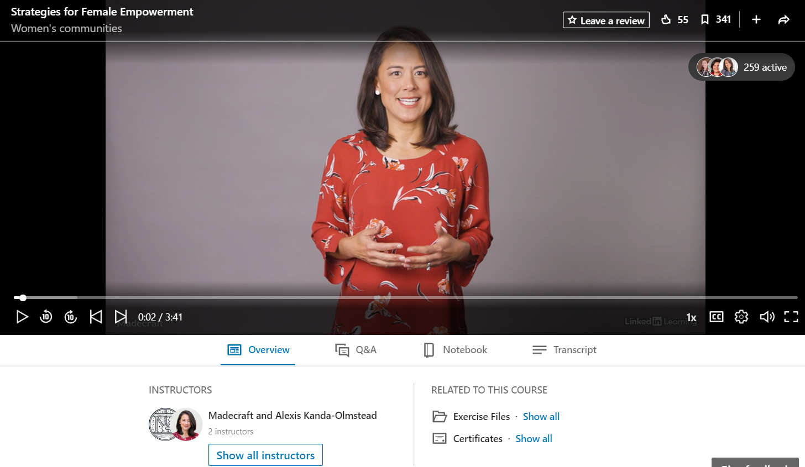

Slide 4

“
Codes have influenced events throughout history, both in the stories of those who make them and those who break them.
The Code Book: The Secret History of Codes and Code-breaking
Notes:
Codes are a language – many times, a secret language – that is used to disguise meaning and – once cracked – can shape the course of history. The betrayal of Mary Queen of Scots, the cracking of the enigma code that helped the Allies in World War II are examples of this.
The tricky part of codes, however, is that not everyone is able to understand them. Only the people who wrote the code or are taught the code can make sense of them.
For women who are working and living in a male-designed world, this can cause any number of negative outcomes. When we don’t know how things work, what happens? Whether it’s using a new app on our phone or taking on a new assignment at work, if we don’t know what to do next, we experience frustration, confusion, and even fear.

Slide 5
Workshop Agenda
Understanding Gender
1
Exploring Confidence
2
Cracking the Code
3

Slide 6
Understanding Gender
Personal, Societal, and Organizational Impacts

Slide 7
Body
Three Dimensions of Gender
Body: Biological basis for one’s experience of gender that is rooted in neurology, endocrinology, and cellular biology.
Identity: One’s internal sense of gender that is inherent and core to who they are.
Social: Includes gender expression and the way society perceives, interacts with, and tries to shape our gender.
Identity
Social
Gender Spectrum: https://genderspectrum.org/
Notes:
Socially-constructed roles and behaviors
Tied to systems of power and oppression

Slide 8


Gender Binary
Boy
Man
Masculine
He/Him
Girl
Woman
Feminine
She/Her
Either/Or
Based on the belief that there are only two genders
Tied directly to systems of power, privilege, and oppression
Reinforces socially-constructed roles and behaviors
Erases transgender and nonbinary people
Limits the full expression of our humanity
Notes:
Socially-constructed roles and behaviors based on assigned sex at birth
Male = Boy, Man, Masculine, He/Him/His
Female = Girl, Woman, Feminine, She/Her/Hers
Tied to systems of power, privilege, and oppression in our societies and organizations
Inequity in hiring, promotion, compensation
Gender bias, discrimination, sexual harassment

Slide 9
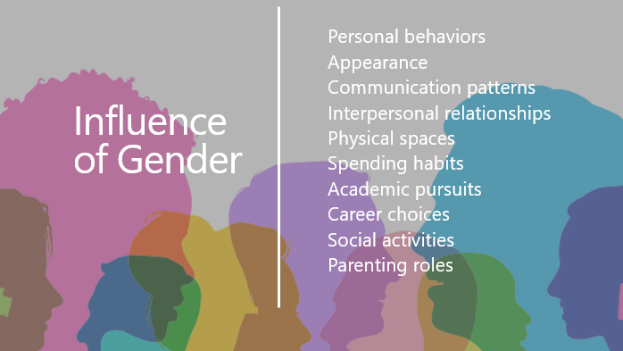

Slide 10

Poll Everywhere
Where has gender influenced your life? (Multiple Choice)
Go to Pollev.com
Username “Dartmouth”
Select “Join”
Skip screen name

Slide 11
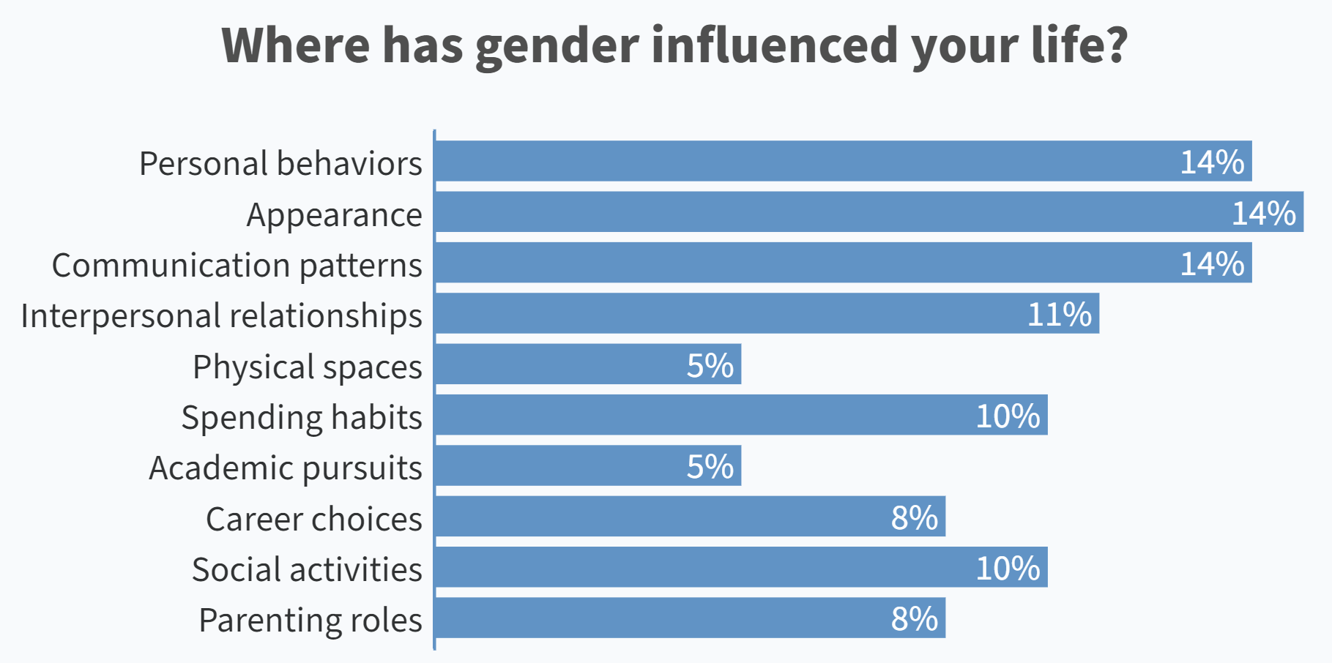

Slide 12



Resting metabolic rate (how fast we generate heat) based on a 40-year-old man weighing about 154 pounds
Fits a 5’8” to 5’10” person
(5’4” = Average woman’s height)
5 – 8 pounds of force
(Based on a man’s arm)
12
Notes:
https://youtu.be/d2NNm8MTboA

Slide 13
Poll Everywhere
Idealized Femininity
What are examples of acceptable behaviors, roles, attitudes, and ways of being for girls and women?
Go to Pollev.com
Username “Dartmouth”
Select “Join”
Skip screen name
Upvote to show agreement

Slide 14
Response | Net Votes
smile | 6
Quiet, sweet and fun | 6
Don't ask so many questions | 6
Do what you are told. | 6
agreeable | 5
Listening and not speaking; rule follower; | 4
Don't be too loud | 3
Stop being so intense | 3
polite | 3
pretty | 3
Pleasing | 2
Behave | 2
Don't be too bossy | 2
Having kids/being a mother | 2
Don't take up to much space | 2
Helpful | 2
Getting married | 2
The world doesn't revolve around you | 1
don't disagree | 1
Find a nice boy to date! | 1
Why are you so serious? | 1
Never interrupt | 1
Being Polite | 1
be less "talkative" | 1
have children | 1
be quieter | 0
agree | 0
That my job is to support my husbands career | 0
Watch your mouth | 0
become a mom | 0

Slide 15
Poll Everywhere
Idealized Femininity
What are examples of unacceptable behaviors, roles, attitudes, and ways of being for girls and women?
Go to Pollev.com
Username “Dartmouth”
Select “Join”
Skip screen name
Upvote to show agreement

Slide 16
Response | Net Votes
being emotional | 10
Bossy | 6
being assertive | 5
Prioritizing career | 5
showing emotion | 5
Talking too much | 4
crying | 4
speaking your mind | 3
RBF | 3
Being plus size... | 3
Aggressive, in a professional sense | 3
Being Assertive | 3
being loud | 2
acting silly | 2
Natural, no makeup | 2
not having children/ get married / etc | 2
being muscular | 1
Being sensitive | 1
Loud | 1
not wearing make-up | 1
strong | 0
You're too pretty to be smart | 0
Bossy | 0
being blunt/honest | 0
not giving in to gossip | 0
Not dressing correctly | 0

Slide 17

Boxed In by Idealized Femininity
White Cisgender Hetero Able-bodied
Loud
Direct
Sexual
Strong
Angry
Athletic
Independent
Bossy
Smart
Opinionated
Determined
Outspoken
Aggressive
Assertive
Empowered
Leadership
Swearing
Caring
Out of sight
Family first
Warm
Sexy
(But not too sexy)
Put together
Agreeable
Pretty
Quiet
Bubbly
Positive
Dainty
Submissive
Accommodating
Responsive
Nurturing Homemaker
Competitive
Sloppy
Standing up for yourself Argumentative Humor Ambitious
Honest Pushing back Self-interested Proud Old

Slide 18

Boxed Out by Idealized Masculinity
White Cisgender Hetero Able-bodied
Loud
Direct
Sexual
Strong
Angry
Athletic
Independent
Bossy
Smart
Opinionated
Determined
Outspoken
Aggressive
Assertive
Empowered
Leadership
Swearing
Caring
Out of sight
Family first
Warm
Sexy
(But not too sexy)
Put together
Agreeable
Pretty
Quiet
Bubbly
Positive
Dainty
Submissive
Accommodating
Responsive
Nurturing Homemaker
Competitive
Sloppy
Standing up for yourself Argumentative Humor Ambitious
Honest Pushing back Self-interested Proud Old

Slide 19
Exploring Confidence
Imposter Syndrome, Stereotype Threat, and Work

Slide 20



The Gender Gap
CONFIDENCE
Hiring and Promotion
Management and Leadership
Compensation
Mjgraphics / Shutterstock.com

Slide 21

What is Confidence?
Belief that one is capable of successfully meeting the demands of a task
Gendered concept with a masculine bias
Result of gender privilege and oppression
  Women are socialized to feel and act less confidently
  Men on average feel more confident than women (Authentic Overconfidence)
Confidence definition by the American Psychological Association
Chamorro-Premiuzic, T. (2019). Why Do So Many Incompetent Men Become Leaders? (And How to Fix It)

Slide 22
Gender, Confidence, and Work
Attitude | Men | Women
Success | Attribute to Skill | Attribute to Effort and Luck
Failure | Attribute to Bad Luck | Attribute to Inability
Applying for jobs | If they meet 60% of the criteria | If they meet 100% of the criteria
Performance | Higher than Peers | Equivalent to Peers

Slide 23
Gender, Confidence, and Work
Attitude | Men | Women
Success | Attribute to Skill | Attribute to Effort and Luck
Failure | Attribute to Bad Luck | Attribute to Inability
Applying for jobs | If they meet 60% of the criteria | If they meet 100% of the criteria
Performance | Higher than Peers | Equivalent to Peers

Slide 24
Gender, Confidence, and Work
Attitude | Men | Women
Success | Attribute to Skill | Attribute to Effort and Luck
Failure | Attribute to Bad Luck | Attribute to Inability
Applying for jobs | If they meet 60% of the criteria | If they meet 100% of the criteria
Performance | Higher than Peers | Equivalent to Peers

Slide 25
Gender, Confidence, and Work
Attitude | Men | Women
Success | Attribute to Skill | Attribute to Effort and Luck
Failure | Attribute to Bad Luck | Attribute to Inability
Applying for jobs | If they meet 60% of the criteria | If they meet 100% of the criteria
Performance | Higher than Peers | Equivalent to Peers

Slide 26

Imposter Syndrome
Persistent inability to believe that one's success is deserved or has been legitimately achieved as a result of one's own efforts or skills.
1 IN 3 GIRLS
WITH A GRADE POINT AVERAGE
ABOVE 4.0
DO NOT THINK THEY ARE SMART ENOUGH FOR THEIR DREAM CAREER
Hinkelman, L. (2017). The Girls’ Index: New insights into the complex world of today’s girls. Columbus, OH: Ruling Our eXperiences, Inc.

Slide 27

Stereotype Threat
Apprehension about confirming negative stereotypes about one’s group when engaging in specific activities.
Math abilities of young girls
GRE scores of Black students
Athletic performance of white males
Steele, C. M. (2011). Whistling Vivaldi: And other clues to how stereotypes affect us (issues of our time). WW Norton & Company.

Slide 28
Poll Everywhere
When do you experience Imposter Syndrome and Stereotype Threat at work?
Select all that apply
Go to Pollev.com
Username “Dartmouth”
Select “Join”
Skip screen name
Notes:
Making a presentation
Meeting with senior leaders
Apply/interviewing for a job
Contributing my ideas at a meeting
Negotiating for a promotion/raise
Taking on a leadership role

Slide 29
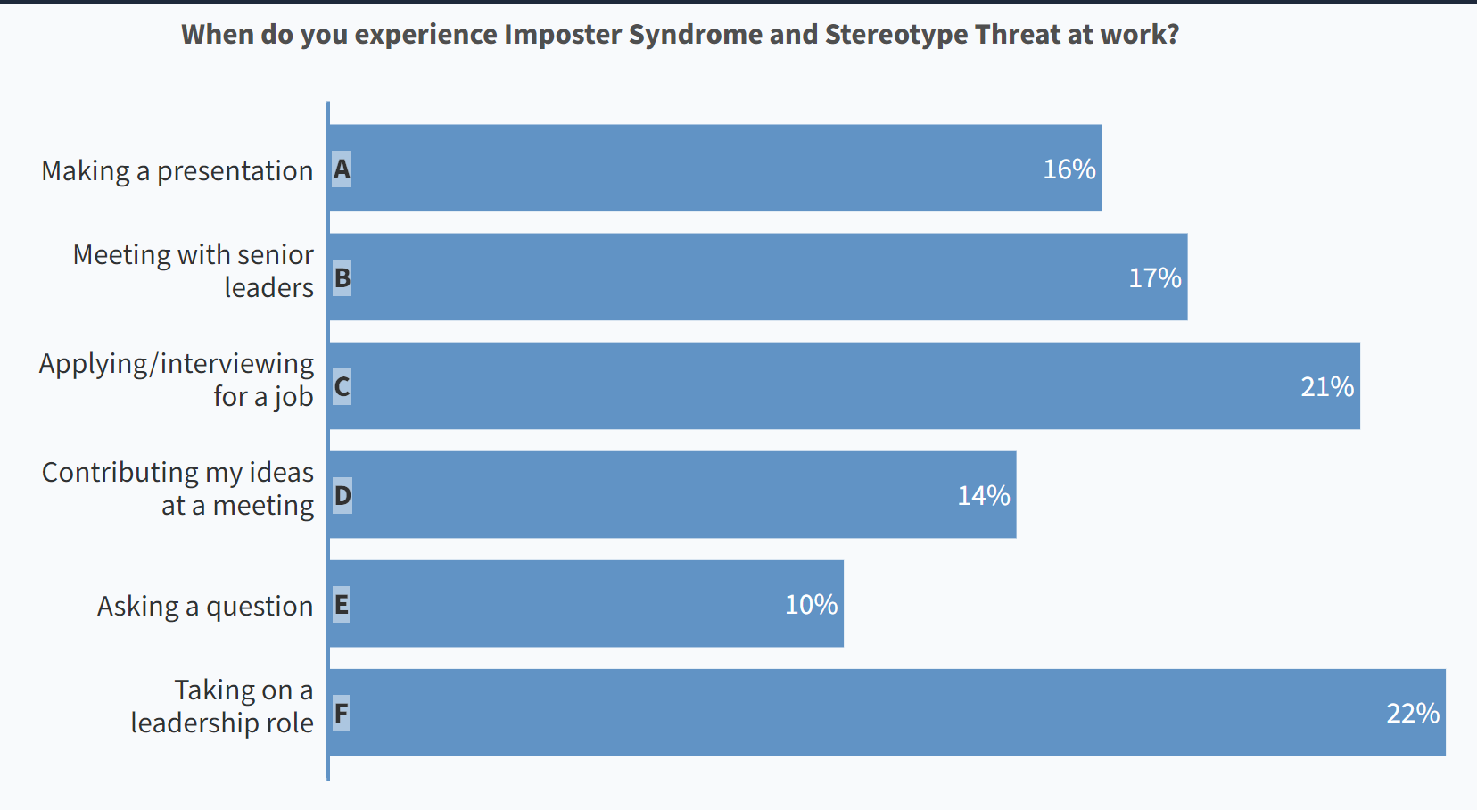

Slide 30
Cracking the Code

Slide 31

The Confidence Myth
CONFIDENCE MYTH
You must be competent and feel confident before you take action.
This Before That
Endless Polishing
Designing at the Whiteboard
Evermore Education
CONFIDENCE CODE
You must be competent and take action before you feel confident.
Kay, K., & Shipman, C. (2014). The Confidence Code: The Science and Art of Self-Assurance--What Women Should Know.
Mohr, Tara. (2014). Playing Big: Find Your Voice, Your Mission, Your Message

Slide 32
60% Confidence Rule
Am I at least 60% confident that I can do this?
(If yes, then do it.)
60% + 40% (Gender Confidence Gap) = 100%

Slide 33
CONFIDENCE CONTINUUM
Step 1
Step 2
Chart along a continuum
Step 3
Step 4
Write down action steps
Identify a goal
Rank order by risk/fear
Step 5
Take one low-risk action in 2 weeks*
*The action must involve another person (email, meeting, phone call, etc.)

Slide 34
Continued Learning & Development
Practice the Confidence Hacks
  60% Confidence Rule
  Confidence Continuum
Find an accountability buddy
Hire a professional coach
Amplify women at work
“Friend me” on LinkedIn ☺
Read a book
  Playing Big: Find Your Voice, Your Mission, Your Message by Tara Mohr
  The Confidence Code: The Science and Art of Self-Assurance – What Women Should Know by Katty Kay and Claire Shipman
  Why Do So Many Incompetent Men Become Leaders? (And How to Fix It) by Thomas Chamorro-Premuzic
  Lead from the Outside: How to Build Your Future and Make Real Change by Stacey Abrams

